Slide 1


RIGA TECHNICAL UNIVERSITY
e-BUSINESS SOLUTIONS
FINAL PRESENTATION

Slide 2


SUBMITTED BY
RAJESHWARI DEVARAJ
PHURBA SHERPA
ARITHA KUMARASINGHE
MADHAVAN MURUGESA
VASANTHI RAAVIPATI

Slide 3



WEB DEVELOPMENT

Slide 4


User-Friendly Design
User-Centric Layout:
Implement a clean and uncluttered layout with a logical flow.
Ensure a simple and intuitive navigation menu.
Maintain consistency in design elements such as colors, fonts, and buttons to reinforce our brand identity.
High-Quality Visuals:
Utilize high-resolution images of book covers, authors, and categories.
Integrate multimedia elements like videos and interactive graphics to engage users.
Easy Access to Information:
Provide detailed book descriptions, author bios, and reviews.
Incorporate a robust search function with filters (e.g., genre, author, price) for easy book discovery.
Accessibility:
Adhere to Web Content Accessibility Guidelines (WCAG) to ensure accessibility for users with disabilities.
Implement features such as text resizing, high contrast mode, and screen reader compatibility.

Slide 5



Responsive Design
Mobile-First Approach:
Design the website with mobile users in mind first, then scale up for larger screens.
Utilize responsive design frameworks like Bootstrap or Foundation.
Flexible Grids and Layouts:
Implement flexible grid layouts that adjust content based on screen size.
Use relative units (percentages, ems) instead of fixed units (pixels) for layout elements.
Adaptive Images:
Use responsive images that adjust the resolution based on the user's device.
Implement lazy loading to improve initial load times on mobile devices.
Testing Across Devices:
Conduct thorough testing on multiple devices and screen sizes to ensure consistent performance.
Use browser developer tools and emulators to simulate different environments.

Slide 6

Efficient Code:
Minimize HTML, CSS, and JavaScript files.
Utilize asynchronous loading for scripts and defer non-critical JavaScript.
Optimize Images and Media:
Compress images using tools like TinyPNG or ImageOptim.
Use modern image formats (e.g., WebP) for better compression.
Content Delivery Network (CDN):
Implement a CDN to serve content from the nearest server to the user.
Reduce latency and improve load times globally.
Caching:
Utilize browser caching for static resources.
Implement server-side caching (e.g., Varnish, Redis) to reduce load times for repeat visitors.
Performance Monitoring:
Use tools like Google PageSpeed Insights, GTmetrix, and Lighthouse to monitor and improve performance.
Fast Load Times

Slide 7

Clear Call-to-Actions (CTAs)
Strategic Placement:
Place CTAs prominently on key pages (home, product, checkout).
Ensure CTAs are visible without scrolling (above the fold).
Compelling Design:
Use contrasting colors for CTAs to make them stand out.
Include concise and action-oriented text (e.g., "Buy Now", "Sign Up", "Subscribe").
Relevant CTAs:
Tailor CTAs to the context of the page and the user's journey.
Use personalized CTAs based on user behavior and preferences.
A/B Testing:
Conduct A/B testing to determine the most effective CTAs.
Continuously refine and optimize CTAs based on performance data.
Happy designing!

Slide 8





ANALYTICS INTEGRATION
Google Analytics Setup
Enhanced E-commerce Tracking
Custom Dashboards and Reports
Google Tag Manager
Create a Google Analytics account and add the tracking code to the website.
Configure goals to track conversions (e.g., purchases, sign-ups).
Implement Enhanced E-commerce tracking to gather detailed data on product performance and user behavior.
Track metrics such as product impressions, add-to-cart actions, and checkout steps.
Create custom dashboards to monitor key performance indicators (KPIs).
Set up automated reports to receive regular updates on site performance.
Use Google Tag Manager to manage tracking codes and tags without modifying the website's code.
Simplify the process of adding and updating tags as needed.

Slide 9

HTTPS and SSL Certificates:
Implement HTTPS to encrypt data transmitted between the user and the server.
Obtain and display SSL certificates to assure users of site security.
Secure Checkout Process:
Use reputable payment gateways (e.g., PayPal, Stripe) to handle transactions.
Ensure PCI compliance to protect payment information.
Trust Badges and Reviews:
Display trust badges from security and payment providers.
Showcase customer reviews and testimonials to build trust.
Data Protection:
Implement strong password policies and two-factor authentication for user accounts.
Ensure compliance with data protection regulations (e.g., GDPR) to safeguard user data.
Regular Security Audits:
Conduct regular security audits and vulnerability assessments.
Keep software and plugins up-to-date to prevent security breaches.
SECURE AND TRUSTWORTHY

Slide 10

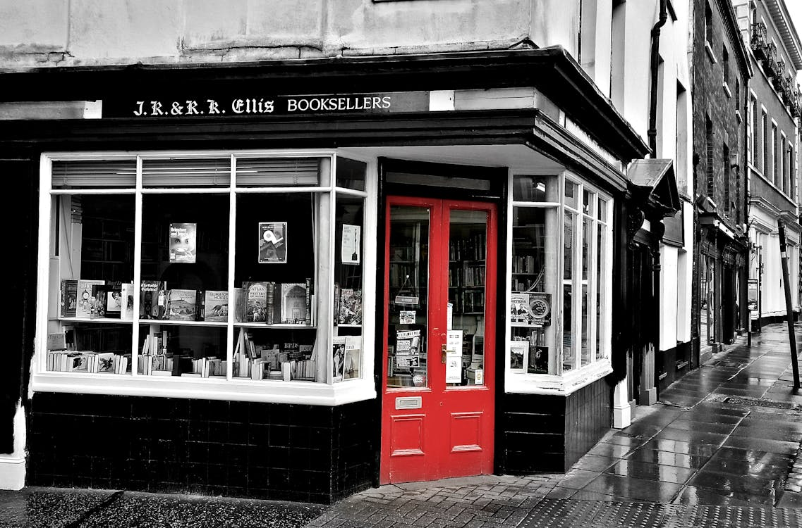

Search Engine Optimization
Keyword research
Identify relevant keywords with high search volume and low competition.
On-page SEO
Optimize title tags, meta descriptions, headers, and content with target keywords.
Technical SEO
Ensure the website has a clean URL structure, fast load times, and is indexed by search engines.

Slide 11
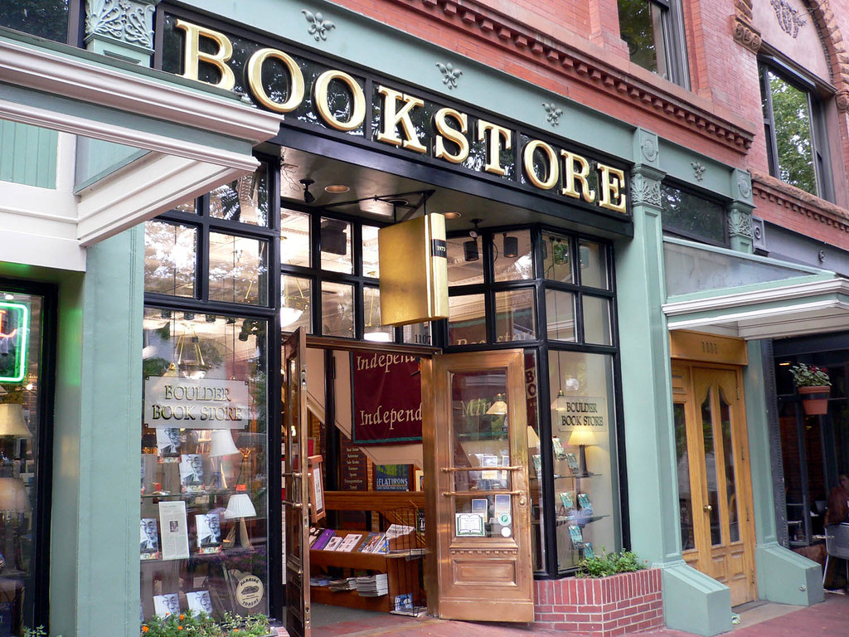
Search Engine Optimization
Content Optimization
Regularly update the website with fresh, keyword-rich content.
Link Building
Develop a strategy for acquiring high-quality backlinks.

Slide 12
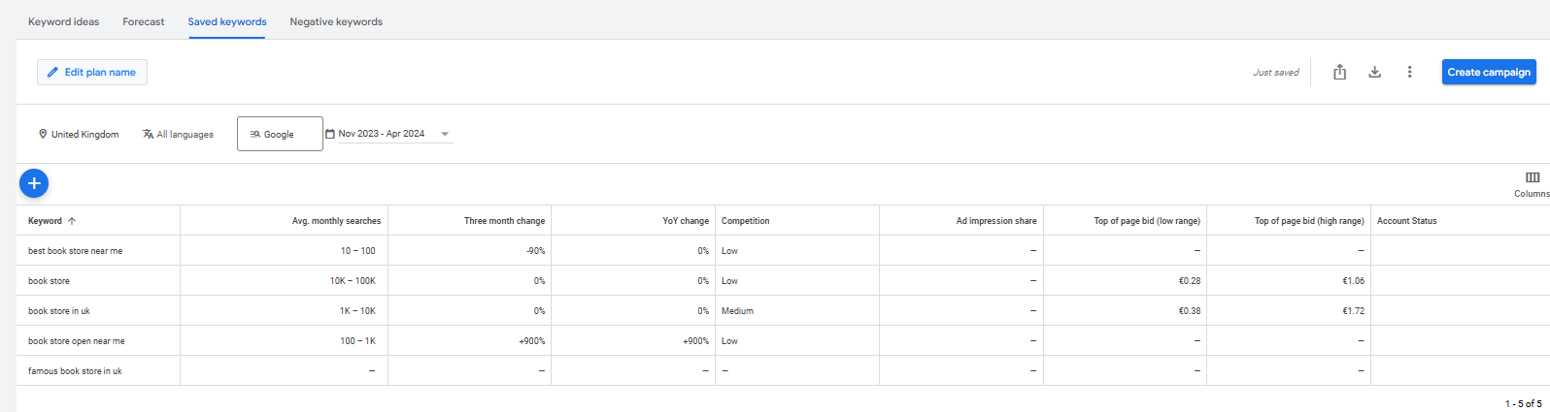
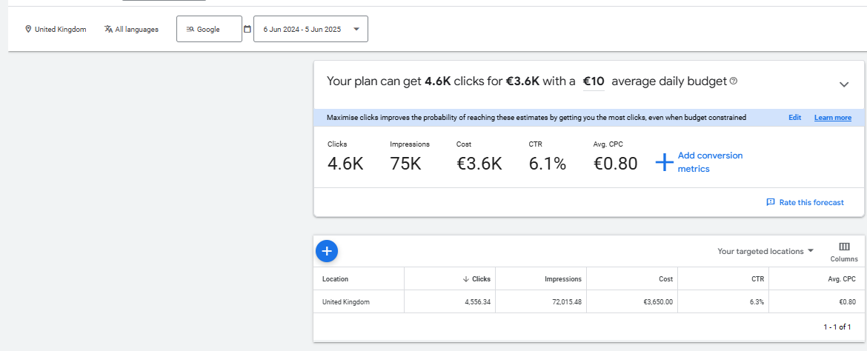

KEYWORD RESEARCH

Slide 13
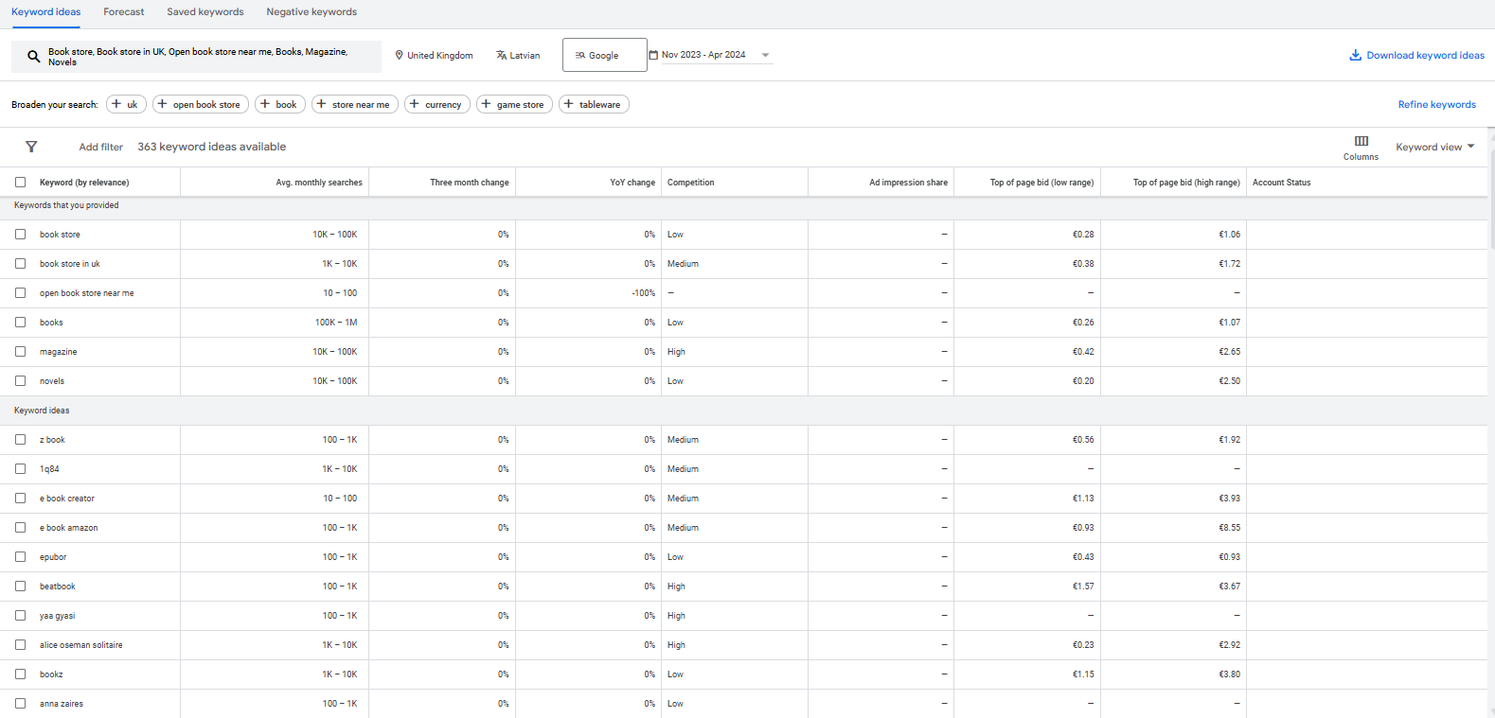

Slide 14
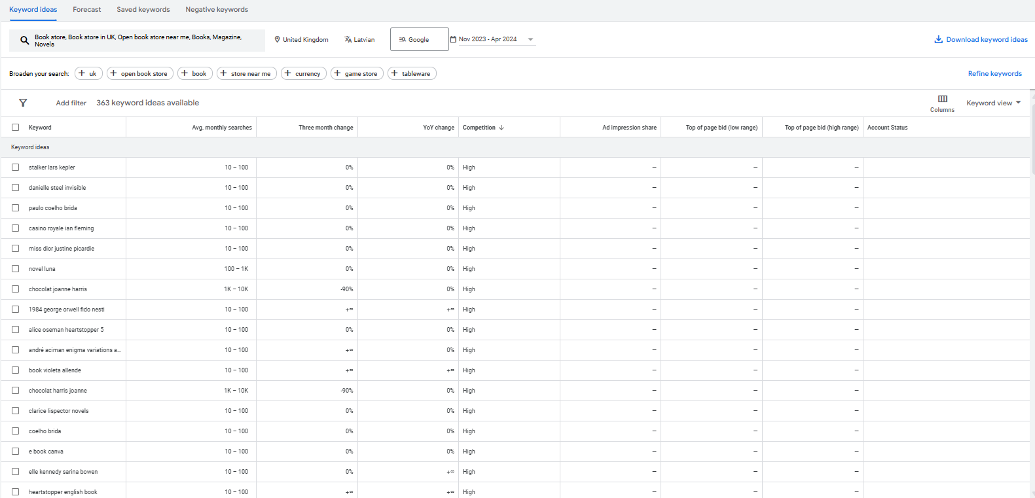

Slide 15
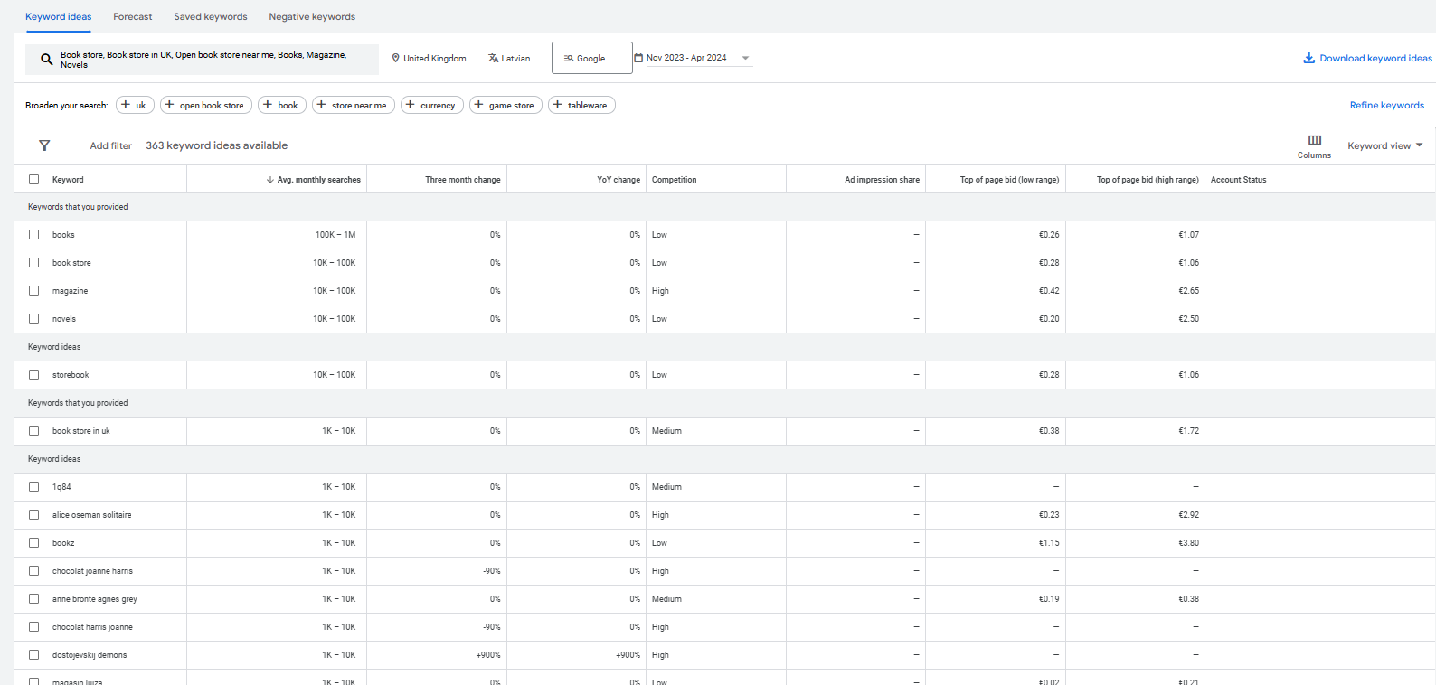

Slide 16
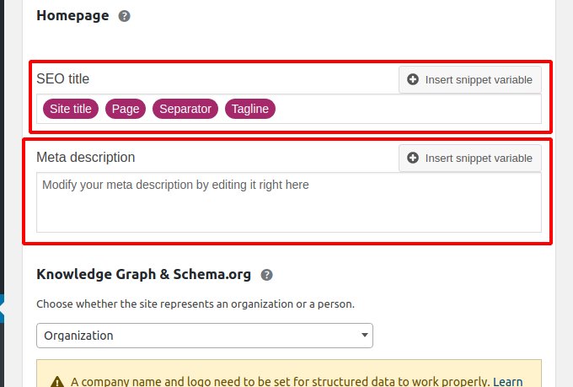

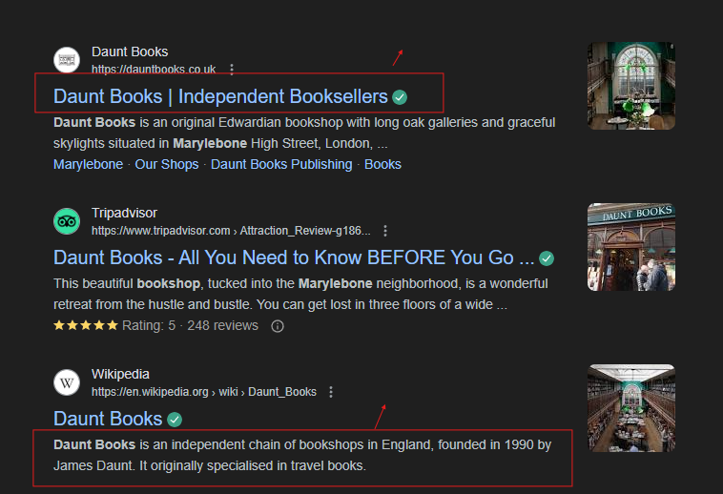

ON-PAGE SEO
SEO Title
E-business solutions
Meta description

Slide 17
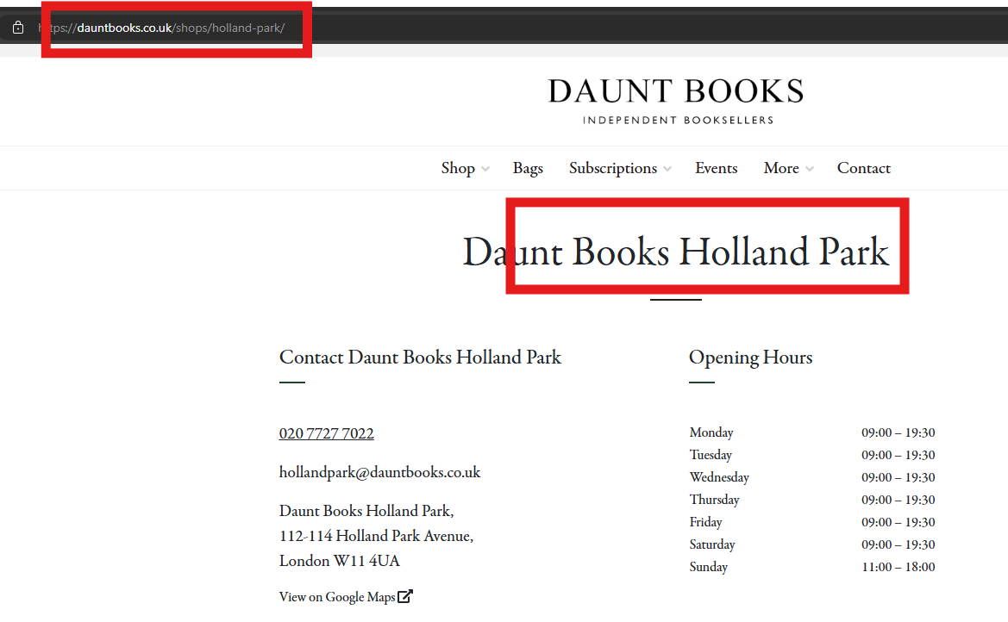

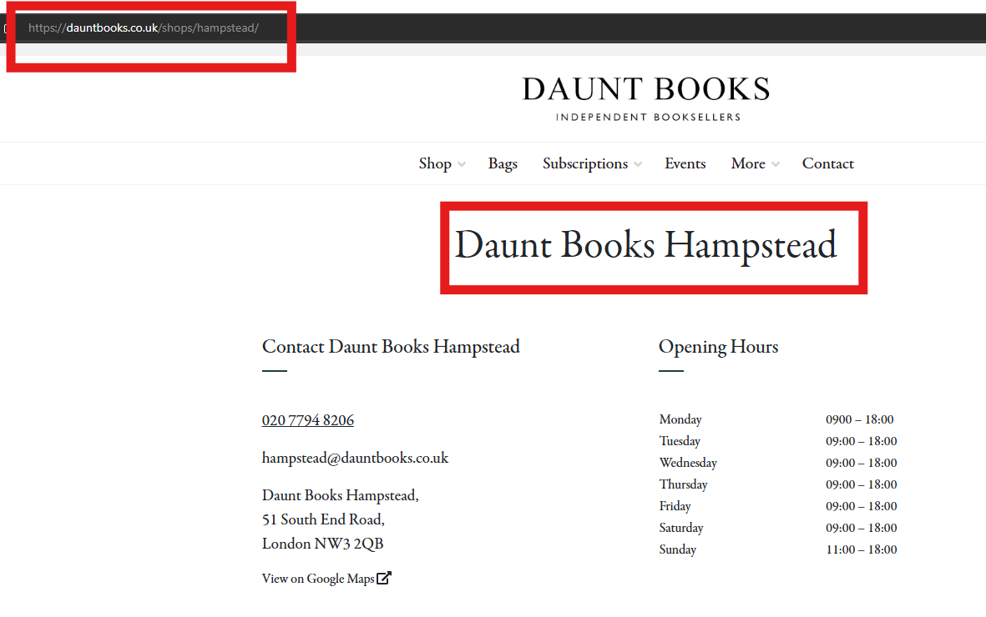
TECHNICAL SEO

Slide 18
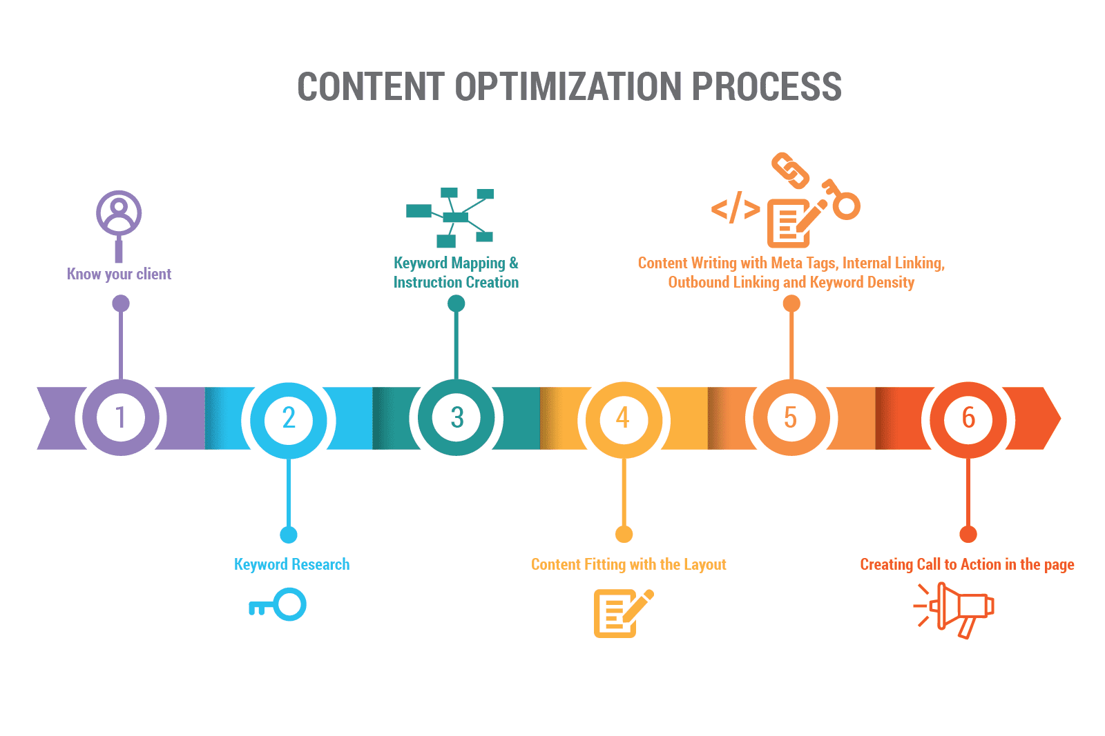
CONTENT OPTIMIZATION

Slide 19
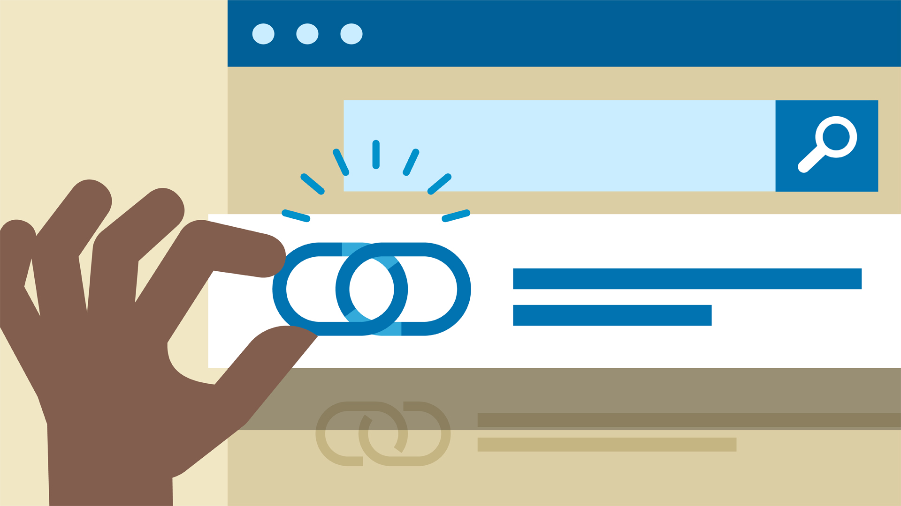
LINK BUILDING
Link building is an essential aspect of SEO. It helps search engines to find and rank your pages. You can write the perfect post, but if search engines can't follow at least one link to it, it will most likely wait forever in vain for visitors to admire its outstanding content.

Slide 20


Paid Advertisements

Slide 21

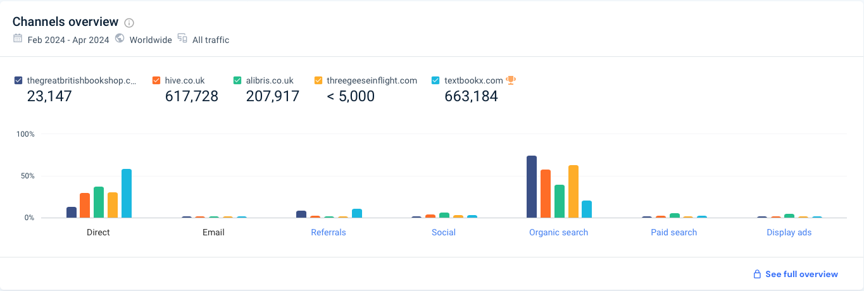
PAID TRAFFIC IN UK BOOKSTORE

Slide 22
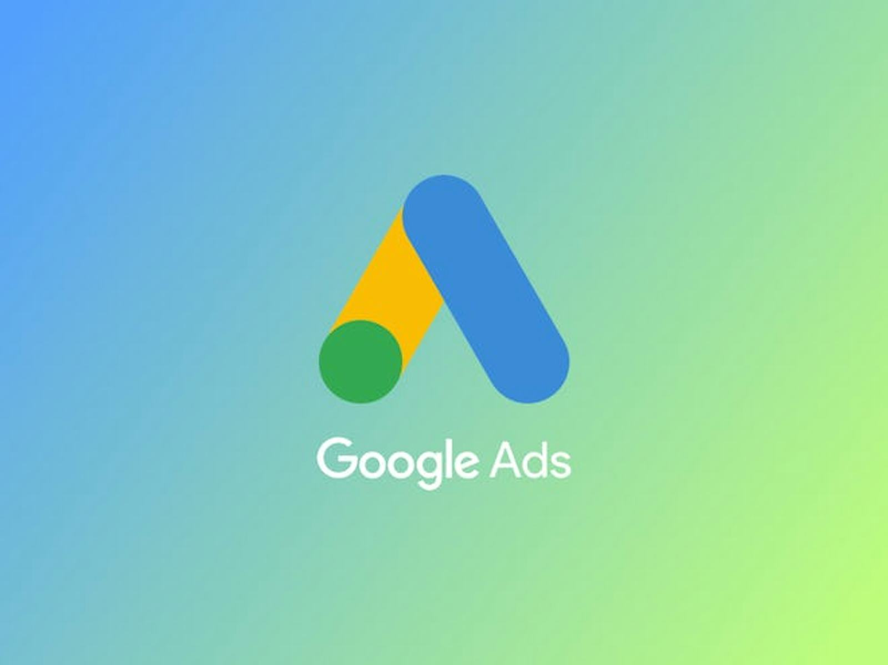


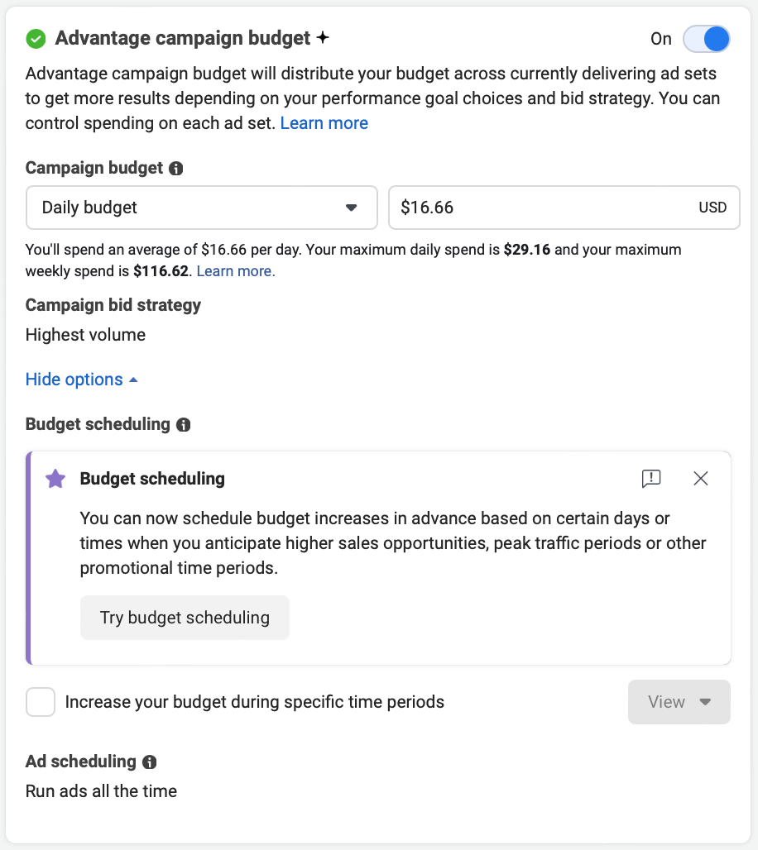
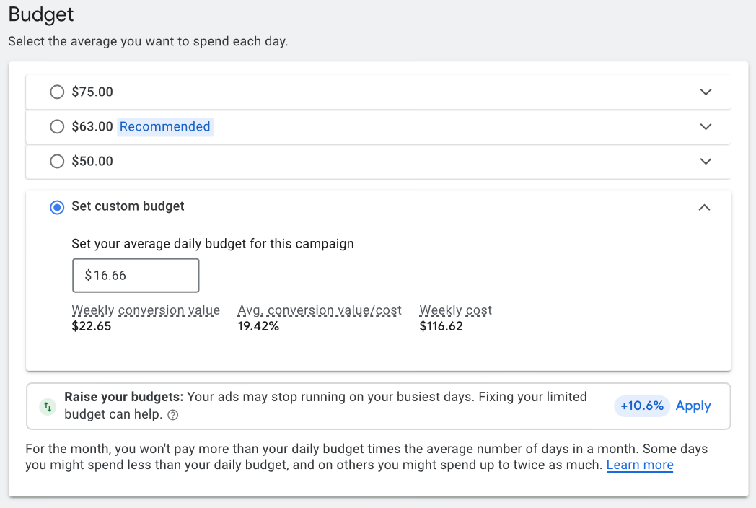
Meta-Logo-1024x576.png.webp
800 GDP
per month
500 USD per Month
500 USD per Month

Slide 23
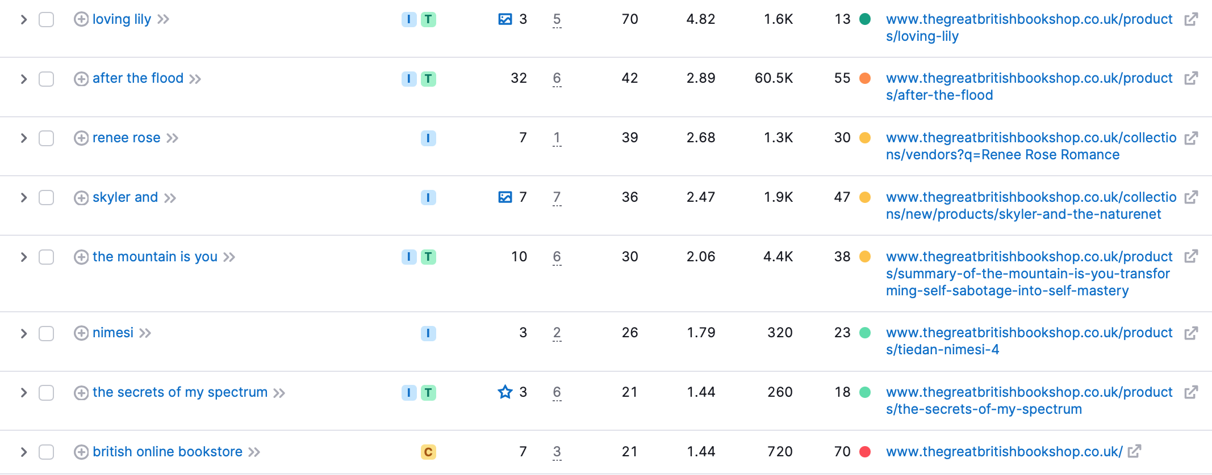

Keywords Associated with UK Bookstores
500 USD per Month
Porvided by:

Slide 24
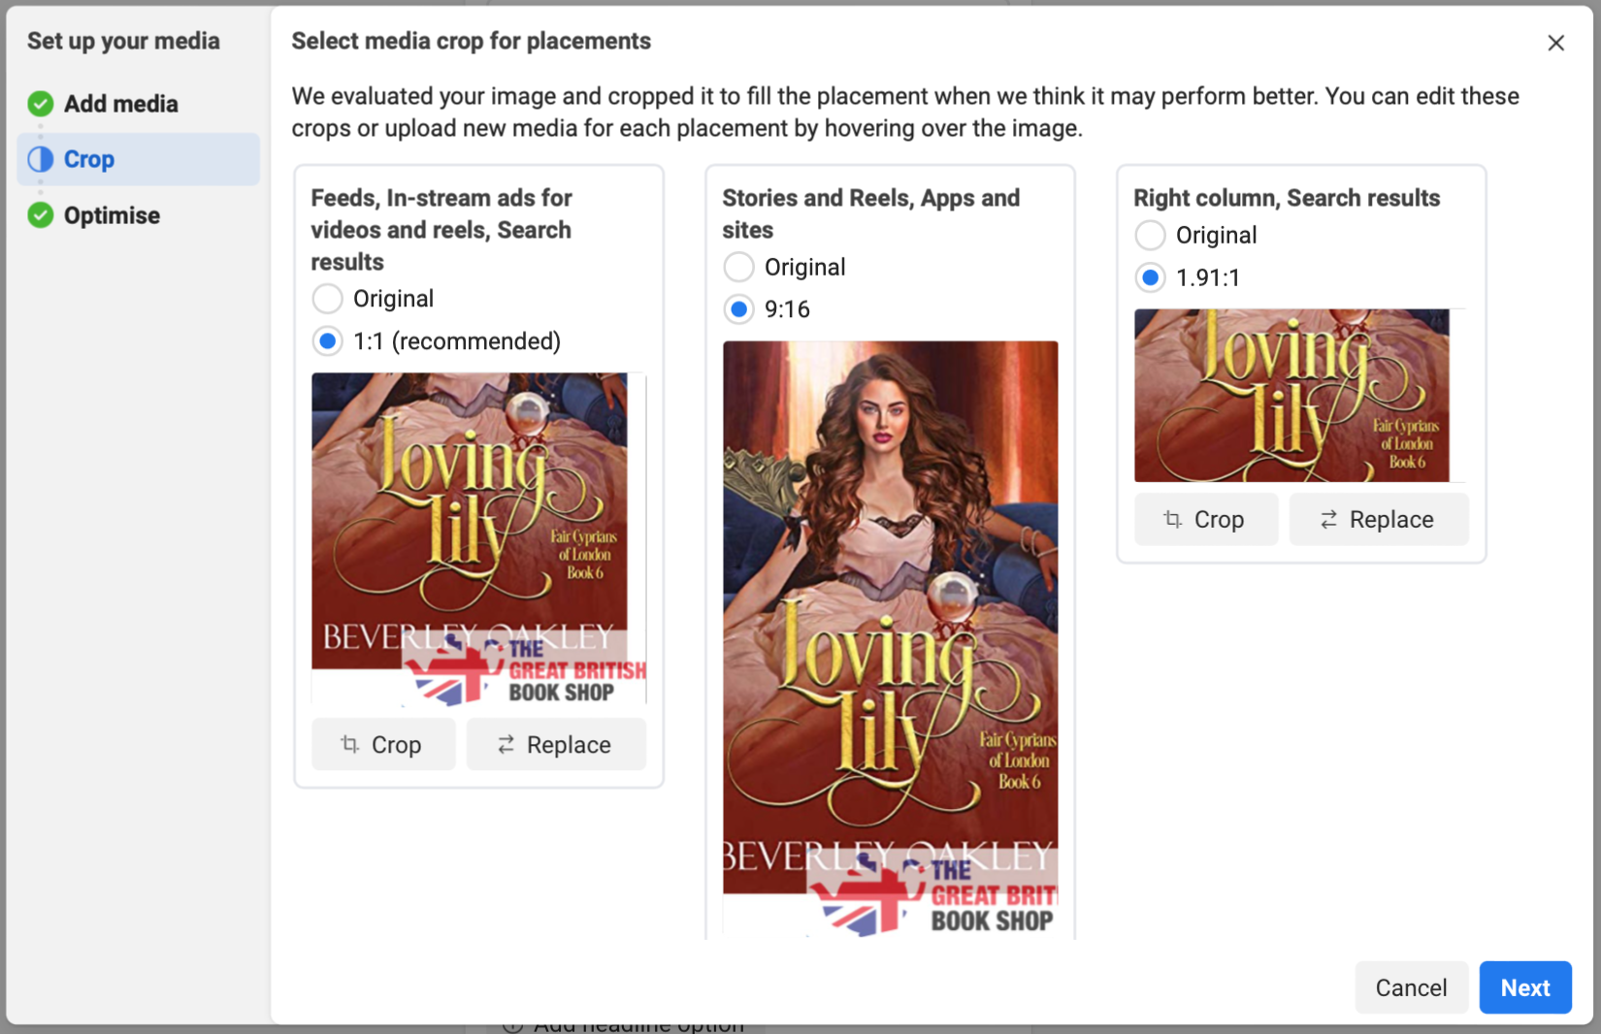
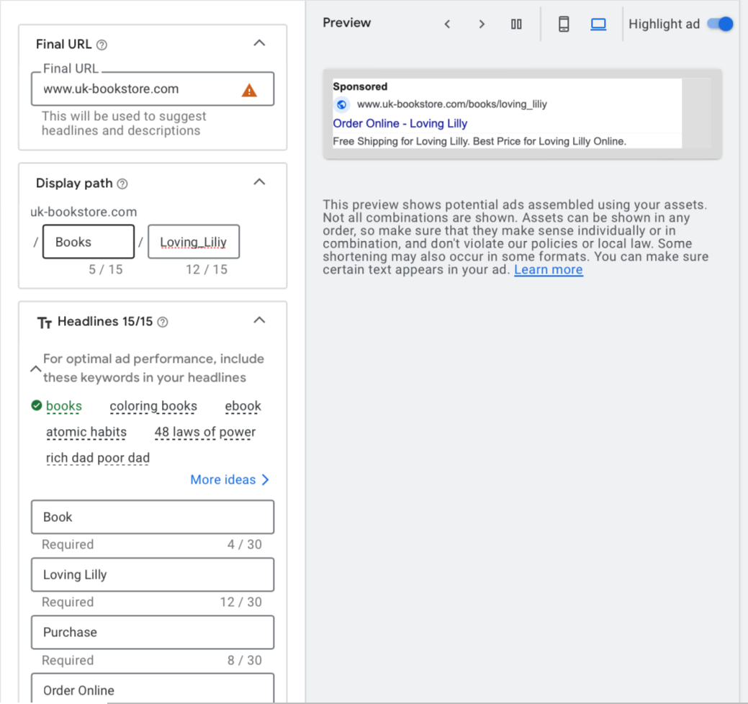






Slide 25
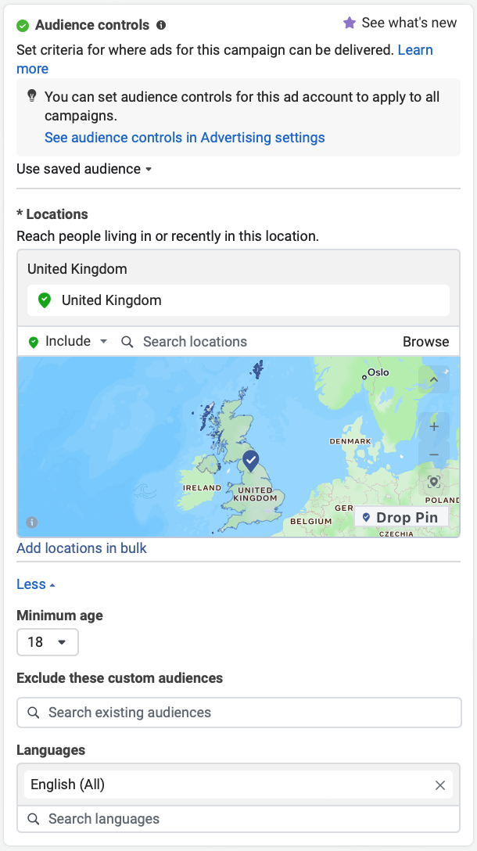
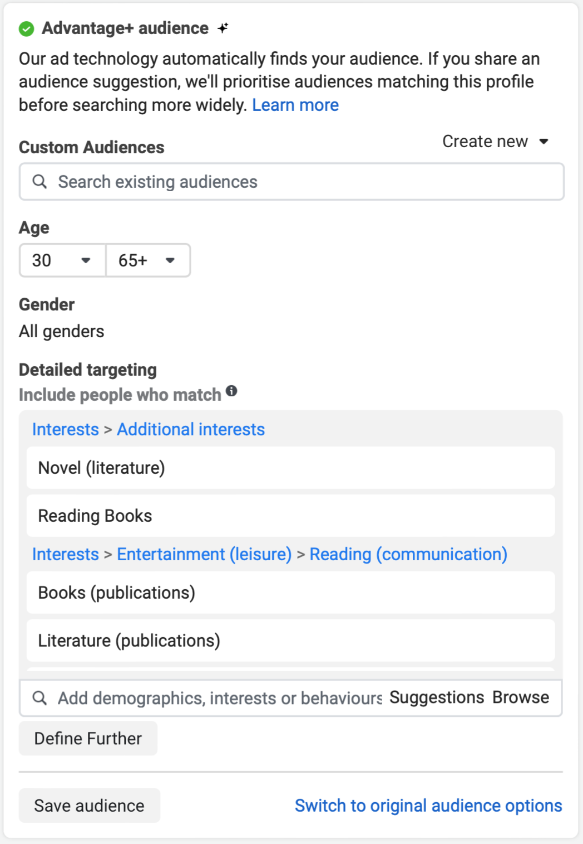
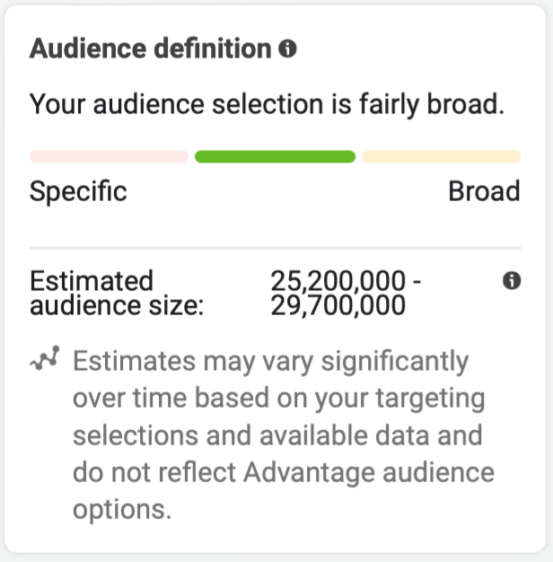
- Targetting

Slide 26
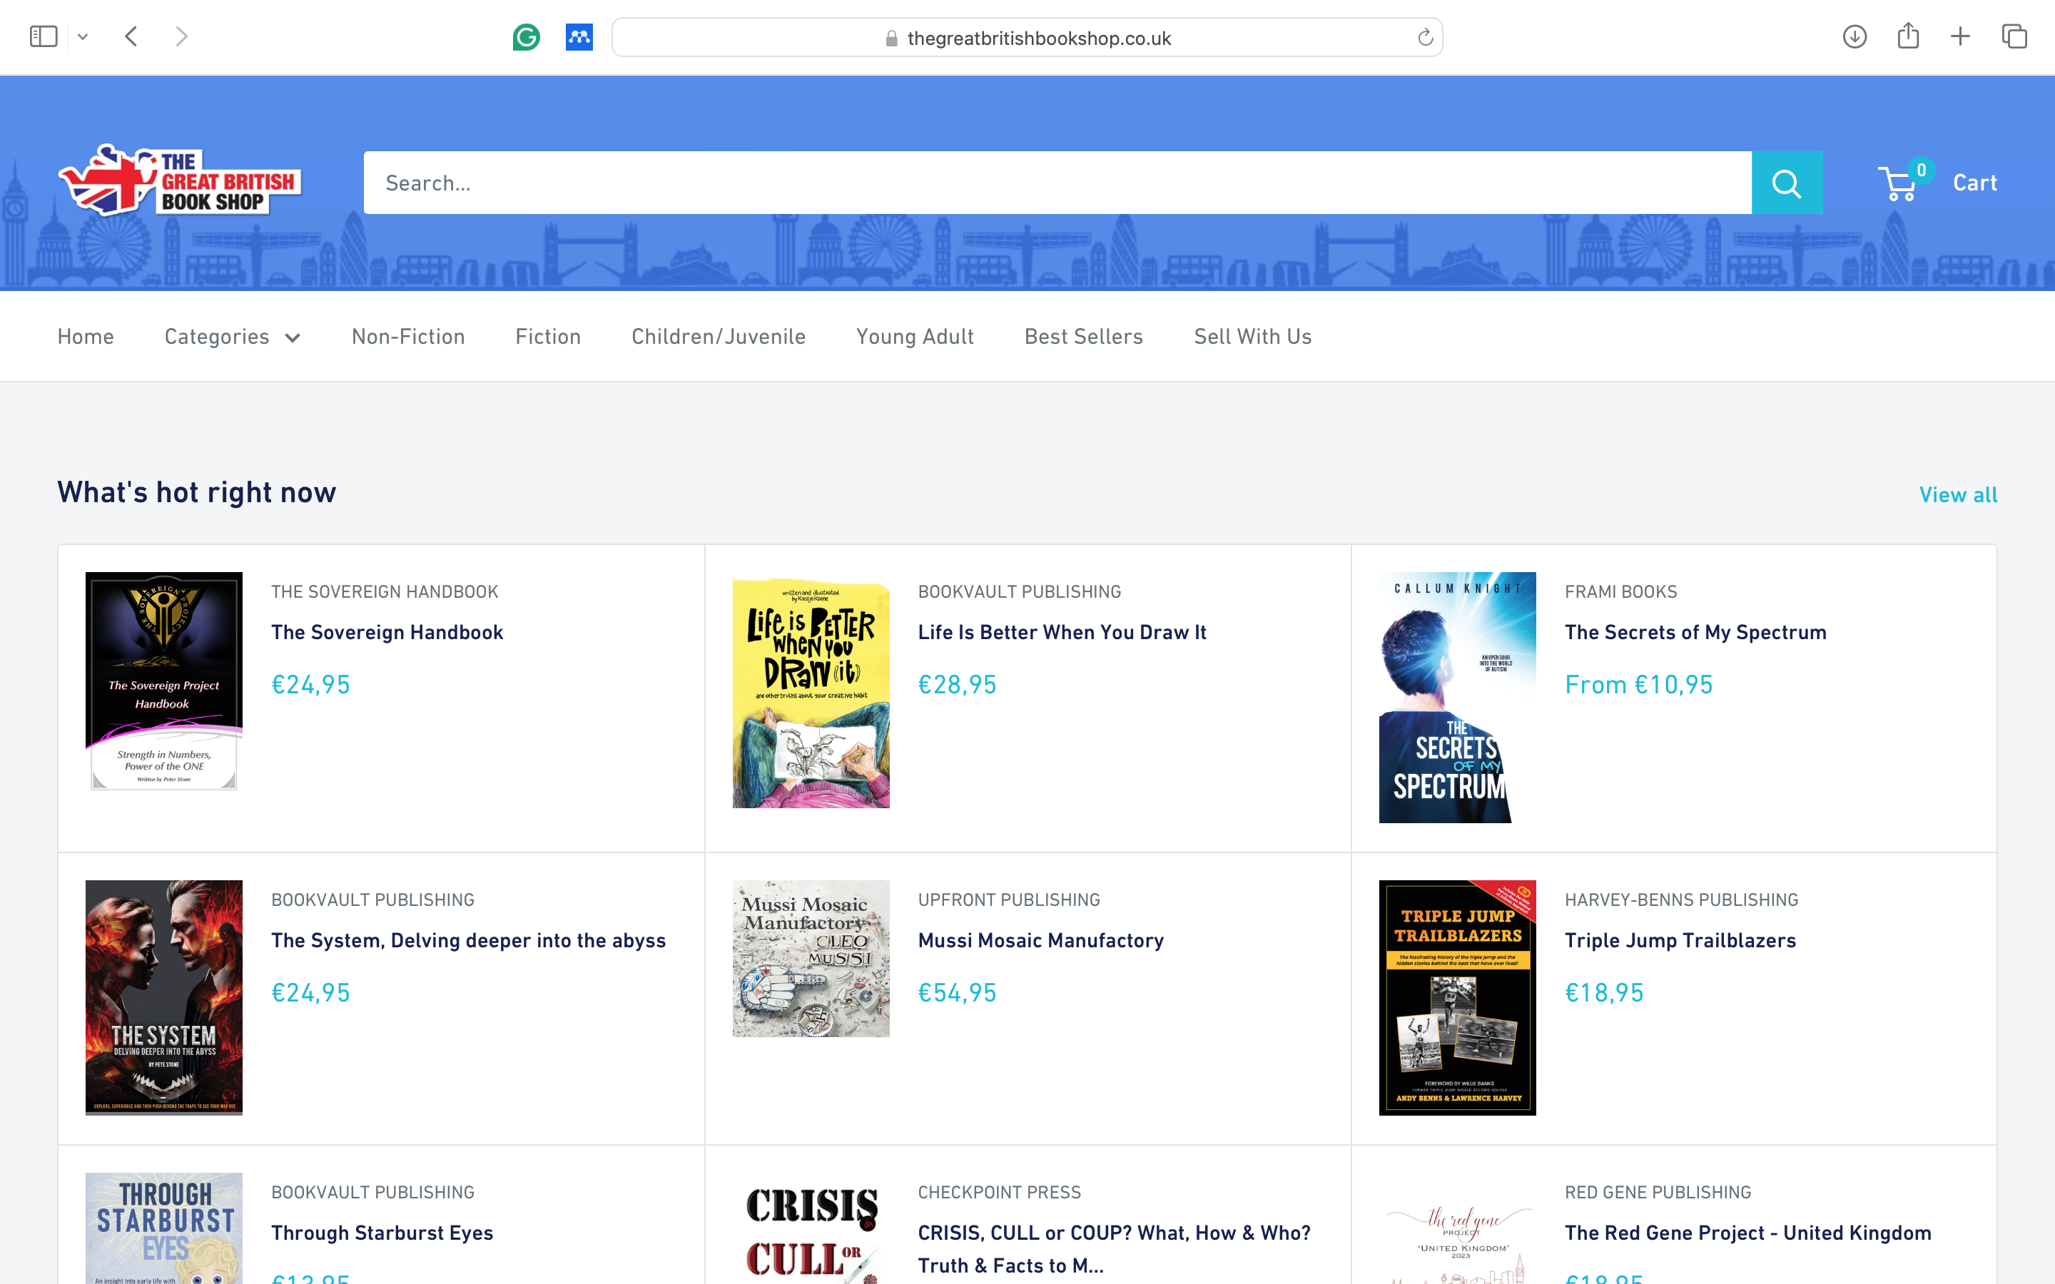
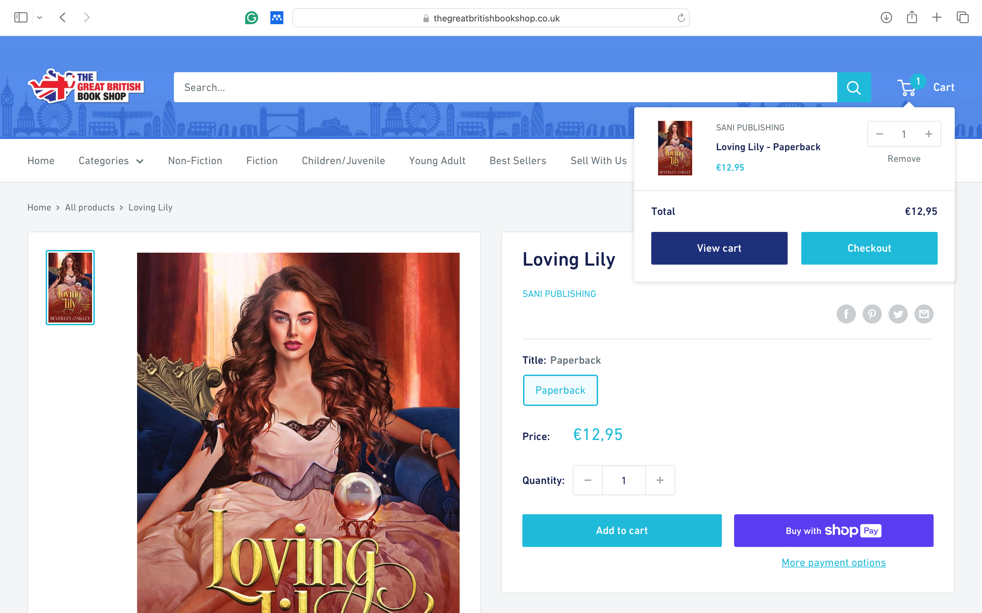

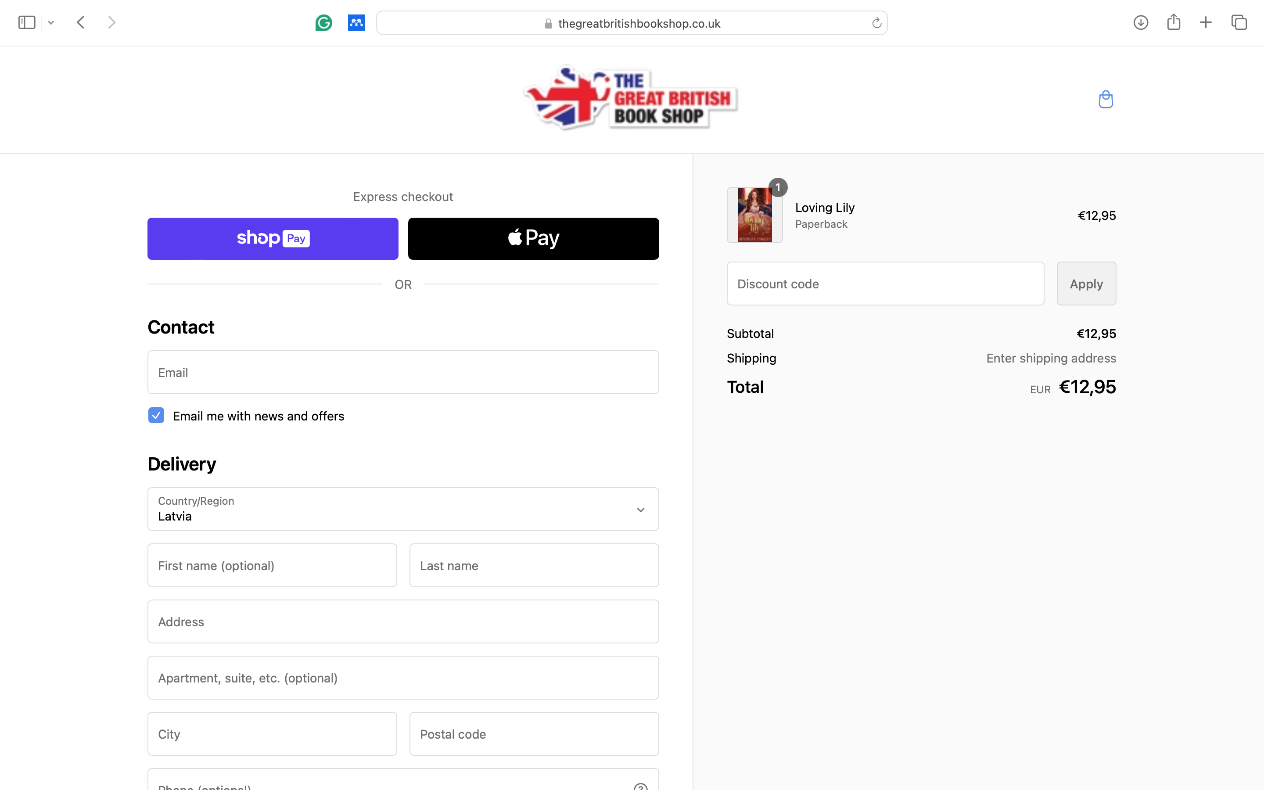
CONVERSION TRACKING
Landing Page
Add to Cart
Purchase
Check Out

Slide 27
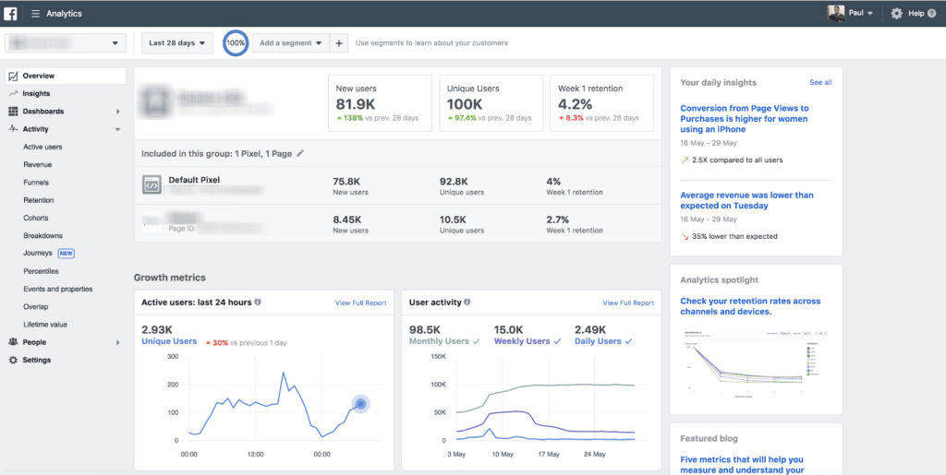

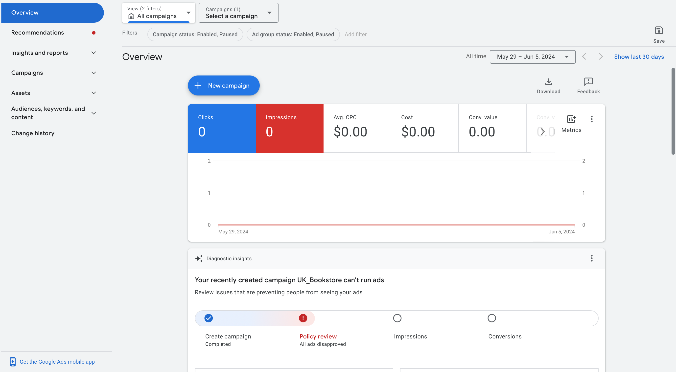
+80 GDP pre-Month
in Sales
800 GDP per month
+%10

Slide 28
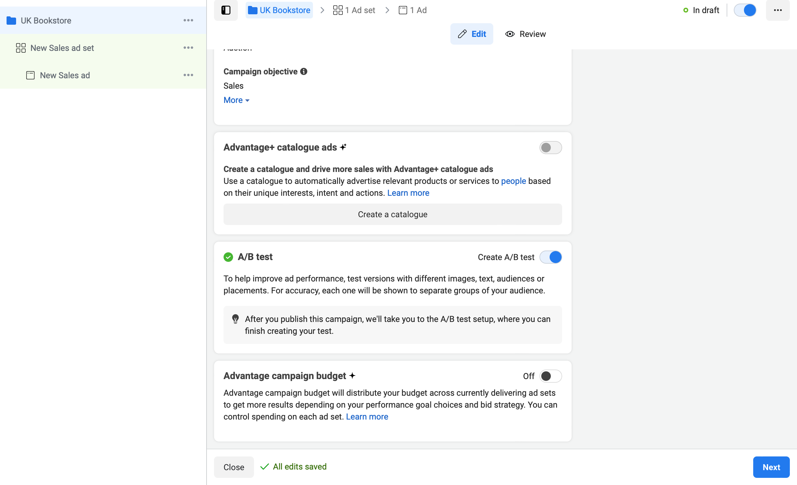
- A/B Testing

Slide 29






Increase the visibility of Book Store within your target market.
Brand Awareness
Build a community of book lovers who actively engage with your content.
Customer Engagement
Drive traffic to your online store and physical locations to increase sales.
Lead Generation
Highlight book launches, author events, and special promotions.
SOCIAL MEDIA MARKETING
Content Promotion

Slide 30
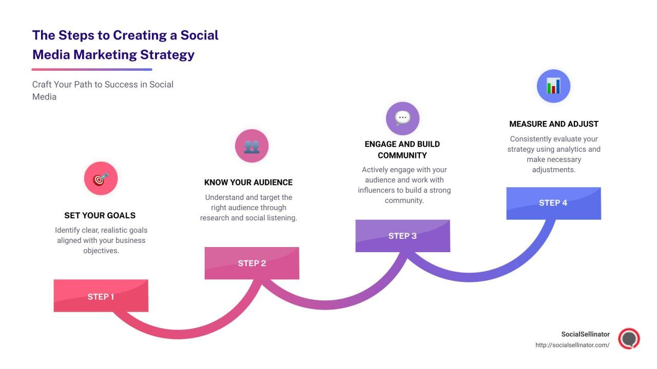

Slide 31

Understanding Your Audience
Demographics
Psychographics
Understand their reading preferences, book-buying behavior, and social media usage patterns.
Identify the age, gender, location, and interests of your target audience.

Slide 32

Choose the Right Platforms
Instagram
Facebook
Twitter
Pinterest
YouTube/TikTok
Use for visually appealing content like book covers, reading nooks, and author events.
Leverage for community building, events, and detailed posts about new arrivals or store news.
Share quick updates, engage in book-related discussions, and connect with authors and publishers.
Create boards for book genres, reading lists, and store ambiance.
Post book reviews, author interviews, and behind-the-scenes content.

Slide 33
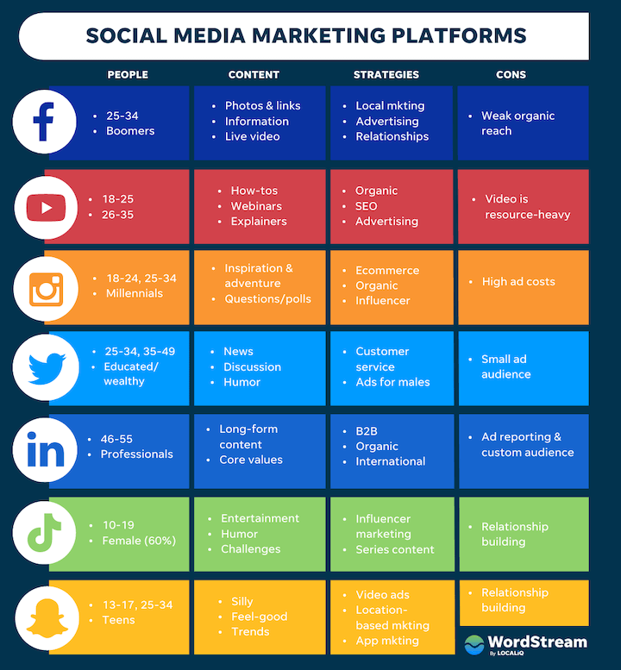

Slide 34

CONTENT STRATEGY
Visual Content: High-quality images of books, store displays, and reading spots.
Videos: Book reviews, unboxing videos, author Q&A sessions.
User-Generated Content: Encourage customers to share their book purchases and reading experiences.
Blog Posts: Share on social media to drive traffic to your website.
Stories and Reels: Short, engaging content showcasing daily store activities or new book arrivals.
Book Recommendations: Curate lists for different genres, moods, and seasons.
Author Spotlights: Feature interviews and background stories of authors.
Events: Promote in-store and virtual events.
Customer Features: Share stories and reviews from your community.

Slide 35
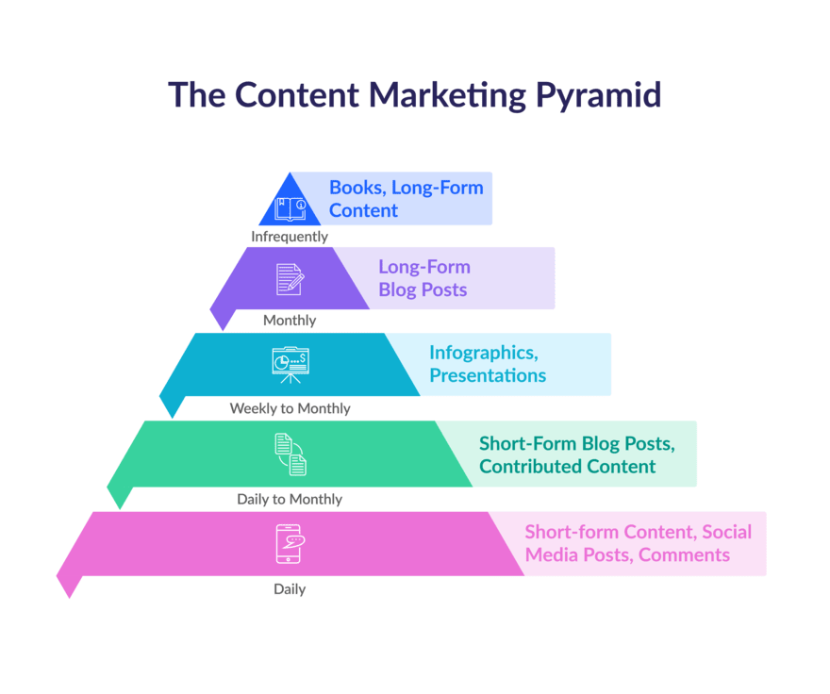

Slide 36


ENGAGEMENT TACTICS
Regular Posting Schedule: Maintain consistency in your posts.
Interactive Posts: Use polls, quizzes, and question prompts to engage your audience.
Respond to Comments: Show appreciation and build relationships by replying to comments and messages.
Hashtags: Use relevant hashtags to increase discoverability (e.g., #BookLovers, #ReadingCommunity, #OmnibusBookStore).

Slide 37






ADVERTISING
Paid Social Media Campaigns
Promotions and Discounts
Collaborations
Offer exclusive deals and discounts to your social media followers.
Partner with influencers and authors for sponsored posts and giveaways.
Run targeted ads to reach a wider audience.

Slide 38
Analytics and Optimization
Track Metrics
Analyze Performance
Adjust Strategy
Monitor engagement rates, follower growth, website traffic, and sales.
Identify which types of content and campaigns are most effective.
Optimize your approach based on data insights and feedback.

Slide 39








Community Building
Book Clubs
Create and promote book clubs through your social media channels.
Reading Challenges
Host reading challenges to encourage participation and engagement.
Customer Involvement
Feature customer reviews and photos regularly.

Slide 40
SAMPLE CONTENT CALENDAR
DAY | CONTENT TYPE | DISCRIPTION
Monday | Book Recommendation | "Must-Read Monday: Top 5 Mystery Novels of the Month"
Tuesday | Author Spotlight | Interview with a bestselling author
Wednesday | User-Generated Content | Feature a photo of a customer with their recent purchase
Thursday | Event Promotion | Details about an upcoming book signing event
Friday | Behind-the-Scenes | Video tour of new book arrivals
Saturday | Interactive Post | Poll: "Which genre are you reading this weekend?"
Sunday | Inspirational Quote | Share a famous literary quote with a beautiful book photo

Slide 41



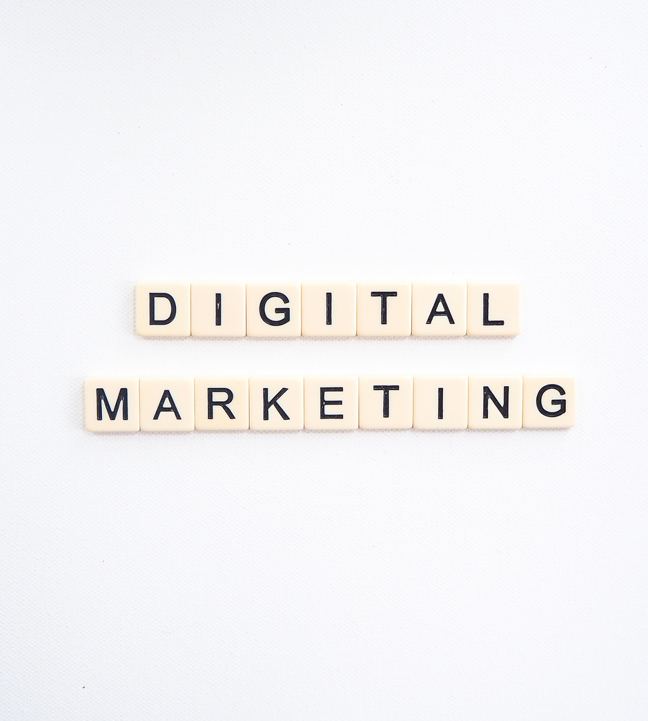
CONTENT MARKETING

Slide 42
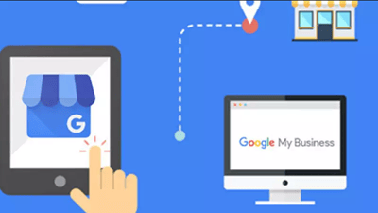
Establish a Strong Domain and Online Presence
Social Media Integration
Integrate social media links and feeds prominently on the website to encourage visitors to connect with the bookstore on various platforms. Ensure seamless navigation between the website and social media channels to enhance engagement and online presence.
Secure Domain and Website
Secure a domain name that reflects the bookstore's brand and is easy to remember. Develop a visually appealing and user-friendly website displaying the offerings, events, and literary community. Integrate social media links prominently to encourage cross-platform engagement.
Visual Appeal
Create a website with an attractive design and user-friendly interface. Showcase the bookstore's products, events, and community in a visually appealing manner. Incorporate high-quality images and graphics to enhance user experience.

Slide 43

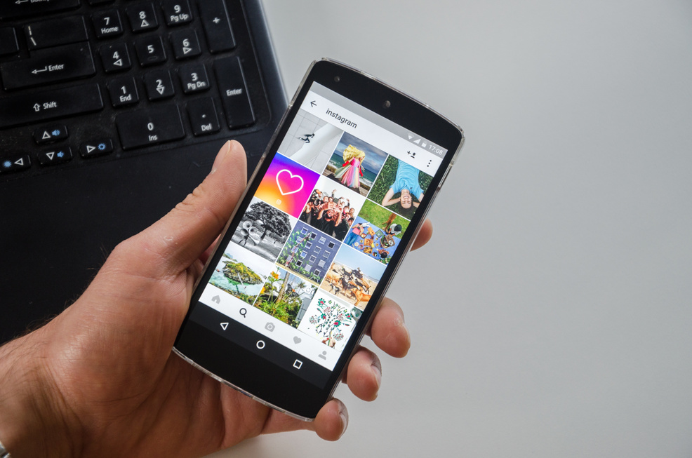
Create a Content Calendar and Editorial Plan
Strategic Planning
Engaging Content
Consistent Posting Schedule
Strategically plan content to align with bookstore events, book launches, and trending literary topics. Ensure the content calendar allows flexibility for timely and relevant posts while maintaining a consistent brand voice and image.
Develop a content calendar outlining a consistent posting schedule across social media platforms. Plan diverse content types such as book reviews, author interviews, literary trivia, and behind-the-scenes glimpses into the bookstore.
Plan engaging content that resonates with the target audience. Incorporate relevant hashtags, user-generated content, and influencer collaborations to increase reach and engagement. Vary content types to maintain audience interest and interaction.

Slide 44


Utilize Facebook for Community Building
Showcasing Store Personality
Create a Facebook page that showcases the unique personality of the bookstore and fosters a sense of community. Regularly share updates on events, book launches, author visits, and reading clubs to engage the audience.
Interactive Content
Encourage discussions and interactions by posting thought-provoking questions, polls, and book-related content that resonates with the target audience. Engage with followers through comments and messages to build a strong community presence.
Targeted Promotion
Run targeted Facebook ads to promote special offers, events, or new book releases to a relevant local or interest-based audience. Utilize Facebook's ad targeting features to reach potential customers and drive traffic to the store.

Slide 45
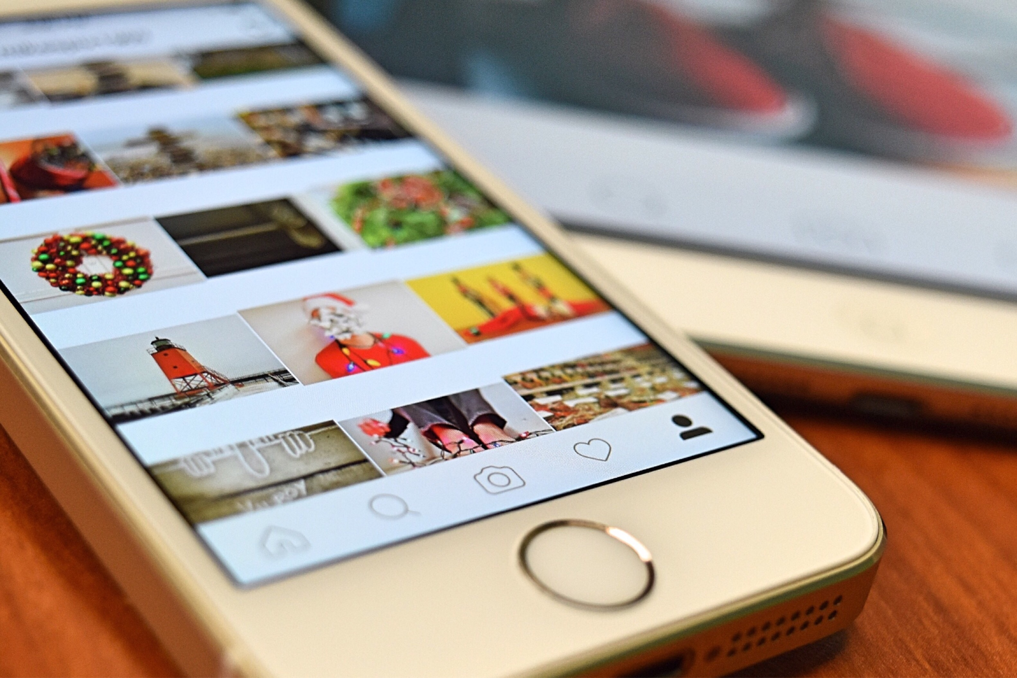
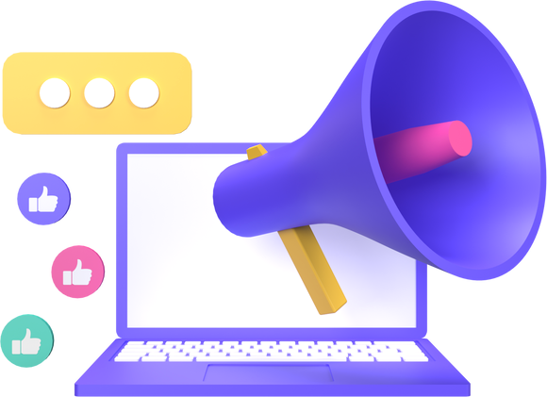
Utilize Instagram for Visual Storytelling
Aesthetic Showcase
Curate a visually appealing Instagram feed that showcases the bookstore's aesthetic, ambiance, and product offerings. Share captivating images, stories behind featured books, author spotlights, and literary quotes to engage the audience.
Engaging Features
Utilize Instagram Stories and Reels to provide behind-the-scenes glimpses, book recommendations, and engaging literary content. Use these features to create interactive and immersive experiences for the audience.
User-Generated Content
Encourage user-generated content by running contests or challenges that prompt followers to share their own book-related photos and experiences. Build a community of book enthusiasts and leverage user content for increased brand visibility.

Slide 46

Engage with the Literary Community on Twitter
Active Participation
Establish a strong Twitter presence by actively participating in book-related conversations, discussions, and trending hashtags. Share bite-sized book excerpts, quotes, and literary trivia to pique interest and engage with followers.
Building Connections
Connect with authors, publishers, and literary influencers to foster valuable relationships and potential collaborations. Engage with the Twitter literary community to position the bookstore as an active and respected participant in the industry.
Real-Time Updates
Leverage Twitter's real-time nature to share updates on events, book signings, and special promotions. Stay responsive and interactive with the audience, keeping them informed about the latest bookstore activities and offerings.

Slide 47


Nurture Professional Connections on LinkedIn
Talent Attraction
Promote employment openings to attract qualified booksellers and staff. Utilize LinkedIn as a recruitment platform to connect with potential employees who are passionate about literature and bookselling.
Networking
Maintain a professional LinkedIn company page for the bookstore to showcase expertise and thought leadership in the literary world. Share insightful book reviews, literary discussions, and author interviews to establish the bookstore as a knowledgeable and reputable source.
Thought Leadership
Network with publishers, writers, and industry professionals for potential collaborations or events. Utilize LinkedIn's professional environment to build partnerships and engage with key stakeholders in the book industry.

Slide 48

E-MAIL MARKETING

Slide 49

Subscriber Engagement
Compelling Content | Curating engaging and informative content such as new releases, book reviews, and author spotlights is essential to captivate subscribers. It keeps them interested and invested in the brand, resulting in higher engagement and response rates.
Exclusive Offers | Rewarding subscribers with exclusive discounts and offers is crucial for fostering loyalty and driving both in-store visits and online purchases. Exclusive offers create a sense of privilege and value for the subscribers, encouraging them to take action.

Slide 50
Community Building
Author Engagement
Event Promotion
Featuring author interviews, behind-the-scenes content, and exclusive insights creates a personal connection with subscribers. This fosters a sense of community and strengthens the bond between the audience and the brand.
Promoting upcoming events and literary gatherings through email marketing is key to encouraging community participation and fostering a sense of belonging. It creates excitement and anticipation, leading to increased event attendance.

Slide 51


Segmented Campaigns
Tailoring email campaigns based on subscriber preferences, purchase history, and engagement is crucial for delivering personalized and relevant content. It ensures that each subscriber receives content that resonates with their interests and behaviors.
Personalized Recommendations
Personalization and Segmentation
Offering tailored book recommendations, event invitations, and content based on subscriber preferences and behaviors enhances the overall subscriber experience. It increases engagement and encourages further interaction with the brand.

Slide 52

Cross-Platform Promotion
Social Media Integration
Integrating social media links and promotions in email campaigns encourages subscribers to engage with the brand across multiple platforms, creating a cohesive and interconnected online presence. It widens the reach and reinforces brand visibility.
Feedback Loop
Encouraging subscribers to share their experiences, recommendations, and feedback fosters a two-way communication channel. This creates opportunities for brand advocacy, enhances relationships with subscribers, and reinforces a sense of community.

Slide 53

Analysis and Optimization
Metrics Tracking
Monitoring open rates, click-through rates, and conversion metrics is essential to measure the effectiveness of email campaigns. It provides valuable insights for understanding subscriber behavior and campaign performance.
Iterative Improvement
Continuously optimizing email content, offers, and segmentation based on subscriber feedback and engagement data is crucial for improving the overall effectiveness and impact of email marketing efforts.

Slide 54


Thank you!

